Slide 1

SOFTWARE ENGINEERING
Software Testing II

Slide 2

Black-Box Testing
Implementation/Programming Guidelines
Software Testing Concepts
Unit Testing
Module Integration and Testing Strategies
Testing Approaches
White-Box Testing
Black-Box Testing
Other Types of Testing

Slide 3
Black-Box Testing
requirements
output
input
events
3

Slide 4
Black Box Testing
Black-box testing is conducted at the software interface to demonstrate that correct inputs results in correct outputs.
Testing software against a specification of its external behavior without knowledge of internal implementation details
It is not an alternative to White Box testing, but complements it.
Focuses on the functional requirements.
Attempts to find errors on
Incorrect or missing functions
Interface errors
Errors in data structures or external database access
Performance errors
Initialization and termination errors
4

Slide 5
Examples: Input Data
Valid data:
user supplied commands
responses to system prompts
file names
computational data
physical parameters
bounding values
initiation values
responses to error messages
mouse picks
Invalid data:
data outside bounds of the program
physically impossible data
proper value supplied in wrong place
5

Slide 6
Examples of Input Domain
Boolean value
True or False
Numeric value in a particular range
99 <= N <= 999
Integer, Floating point
One of a fixed set of enumerated values
{Jan, Feb, Mar, …}
{VisaCard, MasterCard, DiscoverCard, …}
Formatted strings
Phone numbers
File names
URLs
Credit card numbers
6

Slide 7
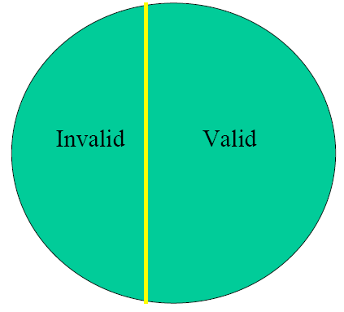
Equivalence Partitioning (1)
First-level partitioning: Valid vs. Invalid input values
7

Slide 8
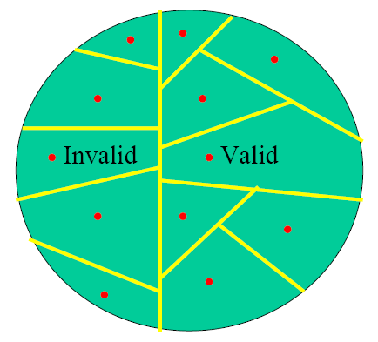
Equivalence Partitioning (2)
Partition valid and invalid values into equivalence classes
Create a test case for at least one value from each equivalence class
8

Slide 9
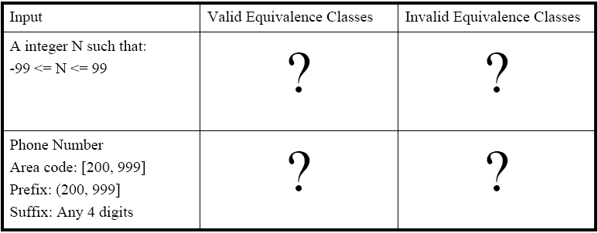
Equivalence Partitioning - Examples
9

Slide 10
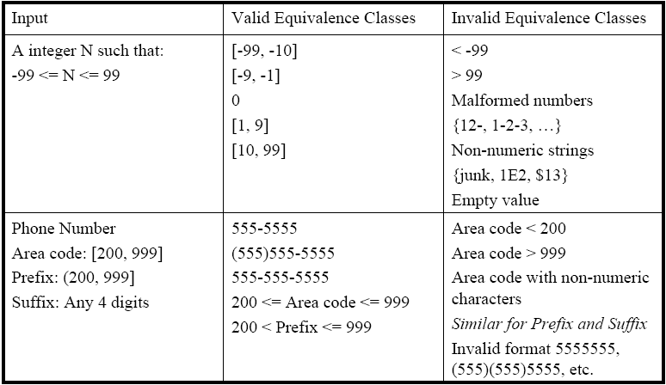
Equivalence Partitioning - Examples
10

Slide 11
Boundary Value Analysis (2)
When choosing values to test, use the values that are most likely to cause the program to fail
If (200 < areaCode && areaCode < 999)
Testing area codes 200 and 999 would catch the coding error
In addition to testing center values, we should also test boundary values
Right on a boundary
Very close to a boundary on either side
11

Slide 12
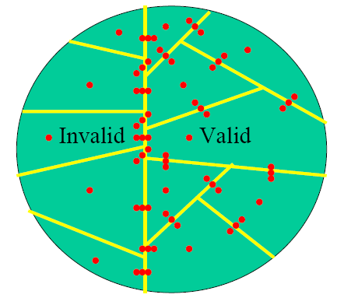
Boundary Value Analysis (3)
Create test cases to test boundaries between equivalence classes.
12

Slide 13
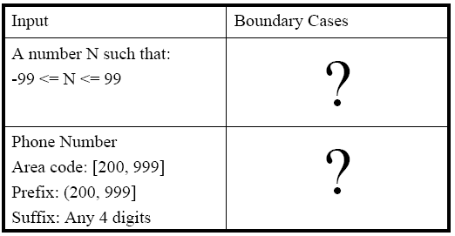
Boundary Value Analysis - Examples
13

Slide 14
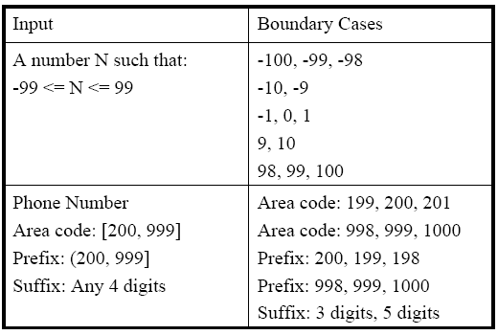
Boundary Value Analysis - Examples
14

Slide 15
Example:
Function Calculating Average
15

Slide 16
Function Calculating Average
// The minimum value is excluded from average.
float Average (float scores [ ] , int length)
{
float min = 99999;
float total = 0;
for (int i = 0; i < length; i++)
{
if (scores[i] < min)
min = scores[i];
total += scores[i];
}
total = total – min;
return total / (length – 1);
}
16

Slide 17
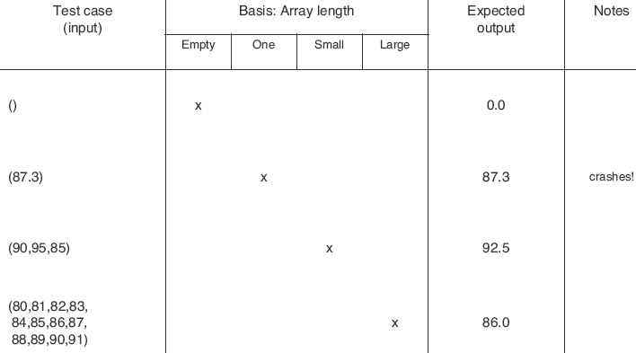
Test Cases (Basis: Array Length)
17

Slide 18
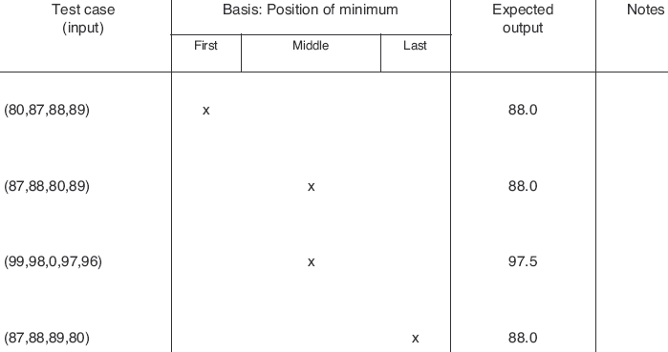
Test Cases (Basis: Position of Minimum)
18

Slide 19
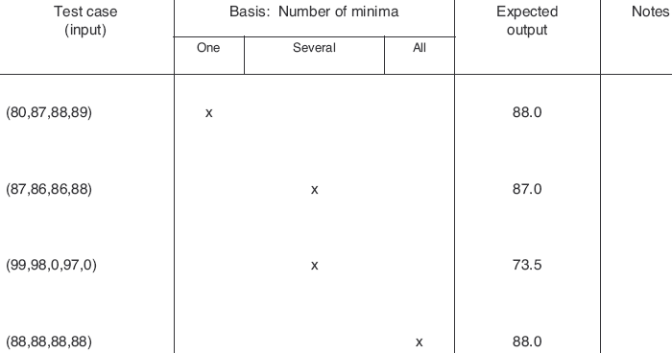
Test Cases (Basis: Number of Minima)
19

Slide 20
Example:
Function Normalizing an Array
20

Slide 21
Function Normalizing an Array
The following C function is intended to normalize an array.
Normalization Algorithm:
First, the array of N elements is searched for the smallest and largest non-negative elements.
Secondly, the range is calculated as max - min.
Finally, all non-negative elements that are bigger than the range are normalized to 1, or else to 0.
There are no syntax errors, but there may be logic errors in the following implementation.
21

Slide 22
C function
1. int normalize (int A[], int N) 2. { 3. int range, max, min, i, valid; 4. range = 0; 5. max = -1; 6. min = -1; 7. valid = 0; 8. for (i = 0; i < N; i++) 9. { 10. if (A[i] >= 0) 11. { 12. if (A[i] > max) 13. max = A[i]; 14. else if (A[i] < min) 15. min = A[i]; 16. valid++; 17. } 18.} | 19. range = max - min; 20. for (i = 0; i < N; i++) 21. { 22. if (A[i] >= 0) 23. if (A[i] >= range) 24. A[i] = 1; 25. else A[i] = 0; 26. } 27. return valid; 28. }
22

Slide 23
Tasks
Draw the corresponding flow graph and calculate the cyclomatic complexity V(g).
Find linearly independent paths for basis path testing.
Give test cases for boundary value analysis.
23

Slide 24
Flow Graph
1-7
19
8-9
20-21
27-28
10-11
22
12
23
13
14
24
25
15
26
16-18
24

Slide 25
Cyclomatic Complexity and Test Paths
Number of edges = E = 21 Number of nodes = N = 16 Cyclomatic complexity = V(g) = E – N + 2 = 21 – 16 + 2 = 7
Path1: 1-7, 8-9, 10-11, 12, 13, 16-18, 19, 20-21, 22, 23, 24, 26, 27-28 Path2: 1-7, 8-9, 10-11, 12, 14, 15, 16-18, 19, 20-21, 22, 23, 24, 26, 27-28 Path3: 1-7, 8-9, 10-11, 12, 14, 16-18, 19, 20-21, 22, 23, 24, 26, 27-28 Path4: 1-7, 8-9, 19, 20-21, 22, 23, 24, 26, 27-28 Path5: 1-7, 8-9, 10-11, 12, 13, 16-18, 19, 20-21, 22, 23, 25, 26, 27-28 Path6: 1-7, 8-9, 10-11, 12, 13, 16-18, 19, 20-21, 22, 26, 27-28 Path7: 1-7, 8-9, 10-11, 12, 13, 16-18, 19, 20-21, 27-28
25

Slide 26
Test cases for boundary value analysis
Test Case-1) Input Condition: N=0, A[ ] = {10, 20, 30, 40, 50} Expected Output: Valid =0 (Due to invalid N value) Test Case-2) Input Condition: N=4, A[ ] = {10, 20, 30, 40, 50} Expected Output: Valid =4 A[ ] = {0, 0, 1, 1, 50} Test Case-3) Input Condition: N=5, A[ ] = {10, 20, 30, 40, 50} Expected Output: Valid =5, A[ ] = {0, 0, 0, 1, 1}
26

Slide 27
Test cases for boundary value analysis
Test Case-4) Input Condition: N=5, A[ ] = {-10, -20, -30, -40, -50} Expected Output: Valid =0 Test Case-5) Input Condition: N=5, A[ ] = {0, 0, 0, 0, 0} Expected Output: Valid =5, A[ ] = {1, 1, 1, 1, 1} Test Case-6) Input Condition: N=5, A[ ] = {10, 10, 10, 10, 10} Expected Output: Valid =5, A[ ] = {1, 1, 1, 1, 1}
27

Slide 28
Other Types of Testing
Implementation/Programming Guidelines
Software Testing Concepts
Unit Testing
Module Integration and Testing Strategies
Testing Approaches
White-Box Testing
Black-Box Testing
Other Types of Testing

Slide 29
Special Tests
Regression testing
Alpha test and beta test
Performance testing
Volume testing
Stress testing
Security testing
Usability testing
Recovery testing
Testing web-based systems
29

Slide 30
System Testing
Functional Testing
Performance Testing
Installation Testing
30

Slide 31
Functional Testing
An alternative form of black-box testing for classical software
We base the test data on the functionality of the code artifacts
Each item of functionality or function is identified
Test data are devised to test each (lower-level) function separately
Then, higher-level functions composed of these lower-level functions are tested

Slide 32
Regression Testing
Each time a new module is added as part of integration testing, the software changes and needs to re-tested.
Regression testing is the re-execution of some subset of tests that have already been conducted to ensure that changes have not propagated unintended side effects.
In broader context, regression testing ensures that changes (enhancement or correction) do not introduce unintended new errors.
When used?
After integration testing
Testing after module modification
32

Slide 33
Performance Testing
33
Measure the system's performance
Running times of various tasks
Memory usage, including memory leaks
Network usage (Does it consume too much bandwidth? Does it open too many connections?)
Disk usage (Does it clean up temporary files properly?)
Process/thread priorities (Does it run well with other applications, or does it block the whole machine?)

Slide 34
Volume Testing
34
Volume testing: System behavior when handling large amounts of data (e.g. large files)
Test what happens if large amounts of data are handled
Load testing: System behavior under increasing loads (e.g. number of users)
Test the system at the limits of normal use
Test every limit on the program's behavior defined in the requirements
Maximum number of concurrent users or connections
Maximum number of open files
Maximum request or file size

Slide 35
Stress Testing
35
Stress testing: System behavior when it is overloaded
Test the limits of system (maximum # of users, peak demands, extended operation hours)
Test the system under extreme conditions
Create test cases that demand resources in abnormal quantity, frequency, or volume
Low memory
Disk faults (read/write failures, full disk, file corruption, etc.)
Network faults
Power failure
Unusually high number of requests
Unusually large requests or files
Unusually high data rates
Even if the system doesn't need to work in such extreme conditions, stress testing is an excellent way to find bugs

Slide 36
Security Testing
36
Try to violate security requirements
Any system that manages sensitive information or performs sensitive functions may become a target for illegal intrusion
How easy is it to break into the system?
Password usage
Security against unauthorized access
Protection of data
Encryption

Slide 37
Acceptance Testing
The client determines whether the product satisfies its specifications
Acceptance testing is performed by
The client organization, or
The SQA team in the presence of client representatives, or
An independent SQA team hired by the client
The key difference between product testing and acceptance testing is
Acceptance testing is performed on actual data
Product testing is preformed on test data, which can never be real, by definition

Slide 38
Alpha Test & Beta Test
Alpha Test
customer tests
software
developer site
customer site
Beta Test
developer reviews
customer tests
software
developer site
customer site
38

Slide 39
Testing Web-based Systems
Concerns of Web-based Systems:
Browser compatibility
Functional correctness
Usability
Security
Reliability
Performance
Recoverability
39
Notes:
39

Slide 40
Examples of Test Automation Tools
Vendor | Tool
Hewlet Packard | QuickTest
IBM | Rational Functional Tester
Selenium | Selenium
Microfocus | SilkTest
AutomatedQA | TestComplete
40

Slide 41
Wrap-up
This week we present
Good Software Implementation Principles
Variable naming, commenting, debugging, etc.
Low Level Testing
Applying Unit Testing
The concept of drivers and stubs
How to integrate the system at overall
Testing Strategies and Approaches
White-box testing and black-box testing
Input domain partitioning
Higher Level Testing

